Slide 1
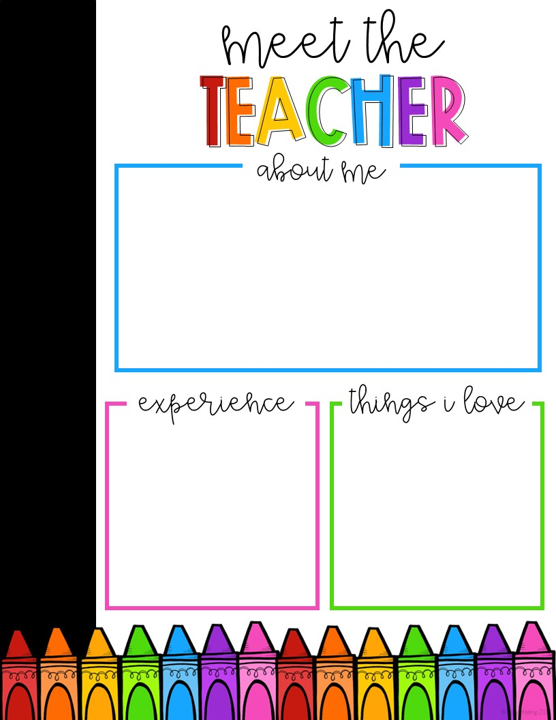
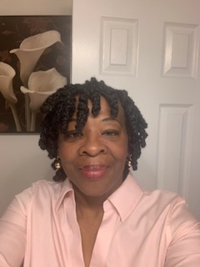
I am a lover of good books and beautiful love songs. I have traveled the world, cooked exotic foods, and danced with a Caribbean beat. Teaching is my livelihood and passion which allows me to encourage students to create a better future for themselves – it gives me joy.
In closing, this year will be engaging, colorful, and nonstop. So, come along and enjoy the adventure!
Mrs. S. Harrington
I put a boa constrictor around my neck.
I have a autograph copy of Hank Aaron’s book.
Cold sliced sweet cantaloupe
Korean food

